Slide 1
Containérisation Applications
Définition du scope de l’étude

Slide 2
Généralités
Docker
Solution de containérisation adoptée par tous les Majors IT
Cross-platform
Peu ou pas de concurrents (Roket, LXC)
Pourquoi les containers
Scalabilité Horizontale
Patch Management
Rapidité / Fiabilité de déploiement
Plate-forme d’exécution
Orchestration déploiement
Orchestration scalabilité
Services associés
Monitoring
Micro Service
Changement architecture applicative

Slide 3
Objectifs du document
Passer en revue les topics liés à la containérisation
Sélection des topics à inclure dans l’étude
Mettre une priorité :
Importante, moyenne, faible

Slide 4
Sommaire
Micro service
Docker
Application cibles
Application développement
Plateforme d’exécution
Architecture
Sécurité

Slide 5
Micro service
Pourquoi ?
Container = Architecture micro services « State less »
Existence d’autres types de micro services
Existence de plateformes dédiées aux micro services
Architecture micro service
Types de micro services
State less
State Full

Slide 6
Annexes

Slide 7
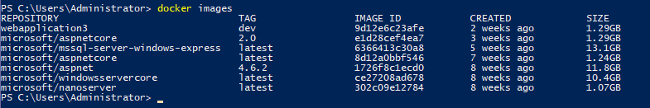

Windows Images
Linux Images

Slide 8
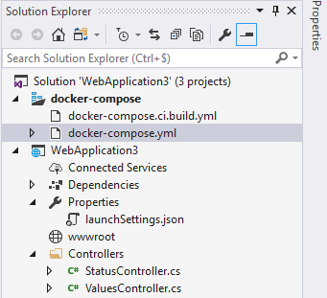
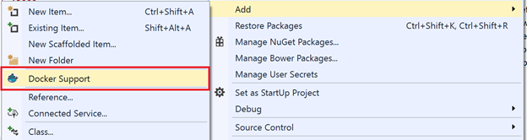
Integration development studio
Visual Studio
2017 : Integrated
2015 : Extension to be installed
Eclipse
Eclipse Neon 4.6.0

Slide 9
Micro Services references
Redhat
https://www.redhat.com/cms/managed-files/mi-microservices-eap-7-reference-architecture-201606-en.pdf
Definition : Page 4
Advantages / Disadvantages : Page 4-5
Cross-Cutting : Page 16

Slide 10
Enterprise image:
Windows 2016
Enterprise hub
Docker hub
microsoft/aspnet
microsoft/aspnetcore
microsoft/dotnet-framework
microsoft/dotnet
Linux RHEL
microsoft/windowsservercore
Windows 2016 nanoserver

Slide 11
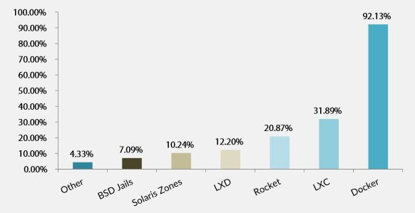
Docker : Standard
Docker is the standard
Resource : http://www.silicon.fr/conteneurs-plebiscites-docker-leader-inconteste-119810.html?inf_by=59fcd2a2681db87f588b4b04 22 juin 2015
Concurents
Resource : https://www.lemarson.com/thematic/1137/les-concurrents-de-docker-oui-ils-existent (2017)
LXC
Rocket By CoreOS
LXD
Solaris Zones
BSD Jails
Open Container Initiative

Slide 12
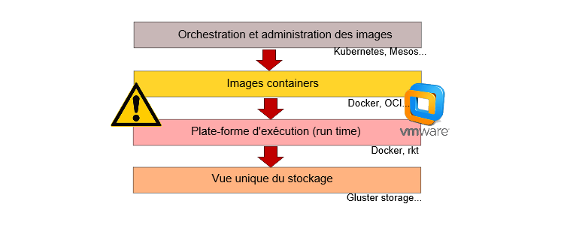
Docker :Concurrents
Model 4 couches Containers
Pourquoi Rocket
Resource : https://www.linformaticien.com/actualites/id/34959/coreos-lance-rocket-son-concurrent-de-docker.aspx (2014)
“Rocket doit se cantonner à un rôle de container, contrairement à Docker qui évolue vers une plateforme globale de services et de gestion. »

Slide 13
Docker : Uses cases
Table of Contents : https://www.gartner.com/doc/3574617/assessing-docker-containers-software-delivery
Analysis
Use Cases for Docker
Summary of Use-Case Assessments
Assessment Criteria
Use Case 1: Docker for Solo and Team Application Development and Test
Use Case 2: Docker for Continuous Integration
Use Case 3: Docker for Production Application Deployment
Use Case 4: Docker for Creating a Private PaaS
Use Case 5: Docker for Application Infrastructure and Cloud Portability
Strengths
Weaknesses
Guidance
Containers Are Not Suitable for Every Application
Use Docker in Production If You Have Sophisticated and Agile Operations
Consider Management, Monitoring, Backup, Disaster Recovery and Other Tools as Well as Orchestration
Plan on a Combination of Containers and Virtual Machines
Don't Build a PaaS Yourself Using Docker, but Build Docker Into Your PaaS Strategy
Gartner Recommended Reading

Slide 14
Docker : Monitoring
Docker is the standard
Concurents
Rocket By CoreOS
Monitoring containers
Resources : http://www.lemondeinformatique.fr/actualites/lire-6-outils-de-suivi-des-conteneurs-concurrents-a-docker-62190.html
cAdvisor by Google :
Open source : github
Simple
Suit uniquement les containers sur le même hôte
Promotheus.io by SoundCloud
Open source
Intégre données de nombreuses sources dont les conteneurs, cAdvisor, Kubernetes, Etcd, CoreOs
Scout
Service de monitoring
Plugin architecture
Price : 10 $ / host
DataDog
Service de monitoring
Reporting plus détaillé / flexible que Scout
Price : 15 $ / host
LogEntries
Service de monitoring
Sematext
Service ou on premise

Slide 15
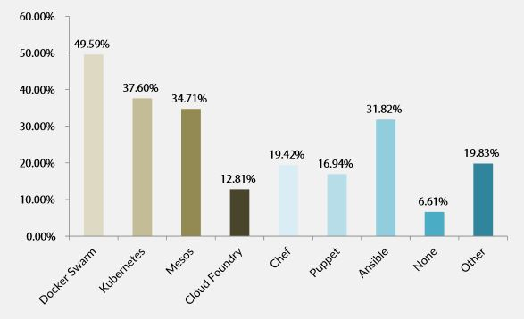
Platform Orchestrators / Services
Platform repartitions
Resource : http://www.silicon.fr/conteneurs-plebiscites-docker-leader-inconteste-119810.html?inf_by=59fcd2a2681db87f588b4b04 22 juin 2015
Resource : https://www.linformaticien.com/actualites/id/45342/docker-rend-les-armes-face-a-kubernetes.aspx (17/10/2017)
« Une étude d’avril dernier réalisée pour le compte de Sysdig, un éditeur de solutions de monitoring des environnements en containers, indiquait que parmi les entreprises ayant déployé des containers, 43 % avaient choisi Kubernetes, 9 % Mesos et 7 % Swarm »

Slide 16
Programmation Langages
.Net Framework
.Net Core
https://docs.microsoft.com/en-us/dotnet/standard/choosing-core-framework-server
Use .NET Core for your server application when:
You have cross-platform needs.
You are targeting microservices.
You are using Docker containers.
You need high-performance and scalable systems.
You need side-by-side .NET versions per application.
Use .NET Framework for your server application when:
Your app currently uses .NET Framework (recommendation is to extend instead of migrating).
Your app uses third-party .NET libraries or NuGet packages not available for .NET Core.
Your app uses .NET technologies that aren't available for .NET Core.
Your app uses a platform that doesn’t support .NET Core.
Java
Others

Slide 17
.Net Core
.Net Core Supported Interfaces
Oracle : http://www.oracle.com/technetwork/topics/dotnet/tech-info/odpnet-dotnet-core-sod-3628981.pdf : Only Managed drivers
.Net Core Not Supported Interfaces
IBM MQ : check version 9.0.x

Slide 18
Resources
Microsoft
NET-Microservices-Architecture-for-Containerized-NET-Applications-(Microsoft-eBook).pdf
Containerized-Docker-Application-Lifecycle-with-Microsoft-Platform-and-Tools-(eBook)_v1.1.pdf
Gartner :
https://www.gartner.com/doc/3574617/assessing-docker-containers-software-delivery
https://www.gartner.com/doc/3512817/need-know-docker-containers

